Slide 1







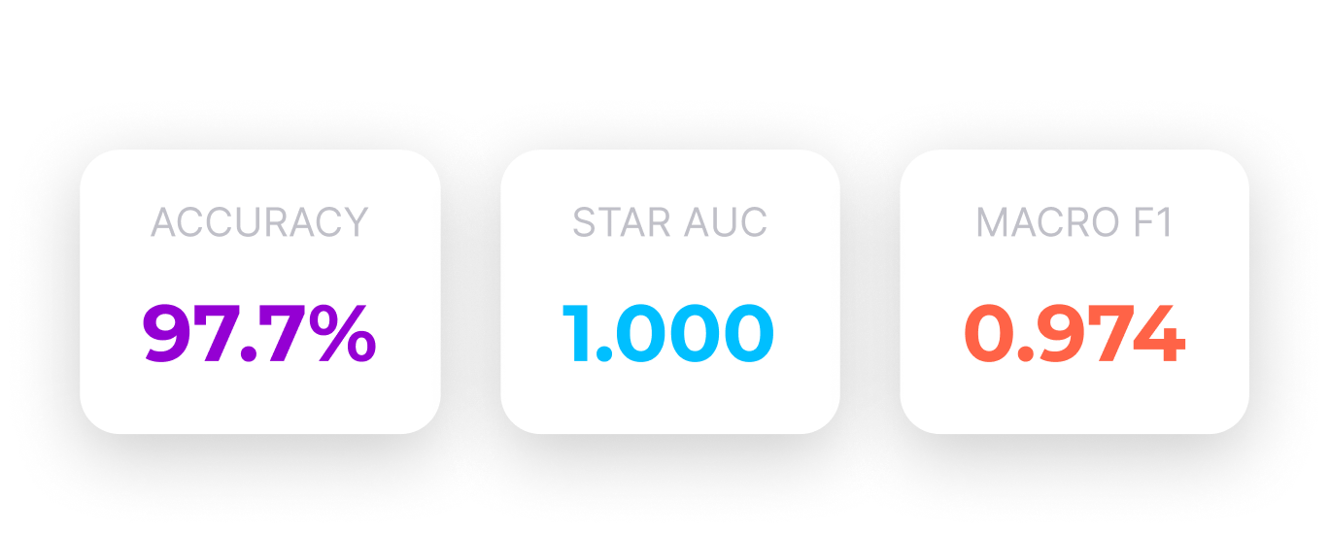
STELLAR OBJECT CLASSIFICATION
Machine Learning Capstone Project: An advanced multi-class classification approach to identify astronomical objects using photometric data
GALAXY QSO STAR
Presented By : AbdulRahman Sami

Slide 2









AGENDA
Introduction
Data Overview
EDA
Feature Engineering
Model Training
Data Pipeline
Result
Interpretability
Deployment
Conclusion

Slide 3
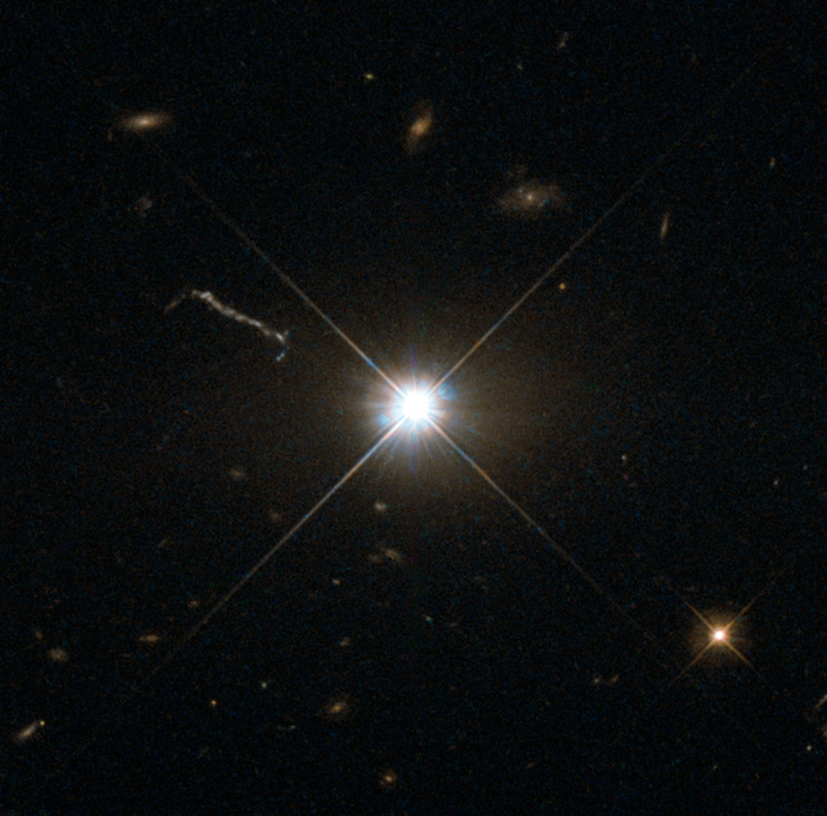
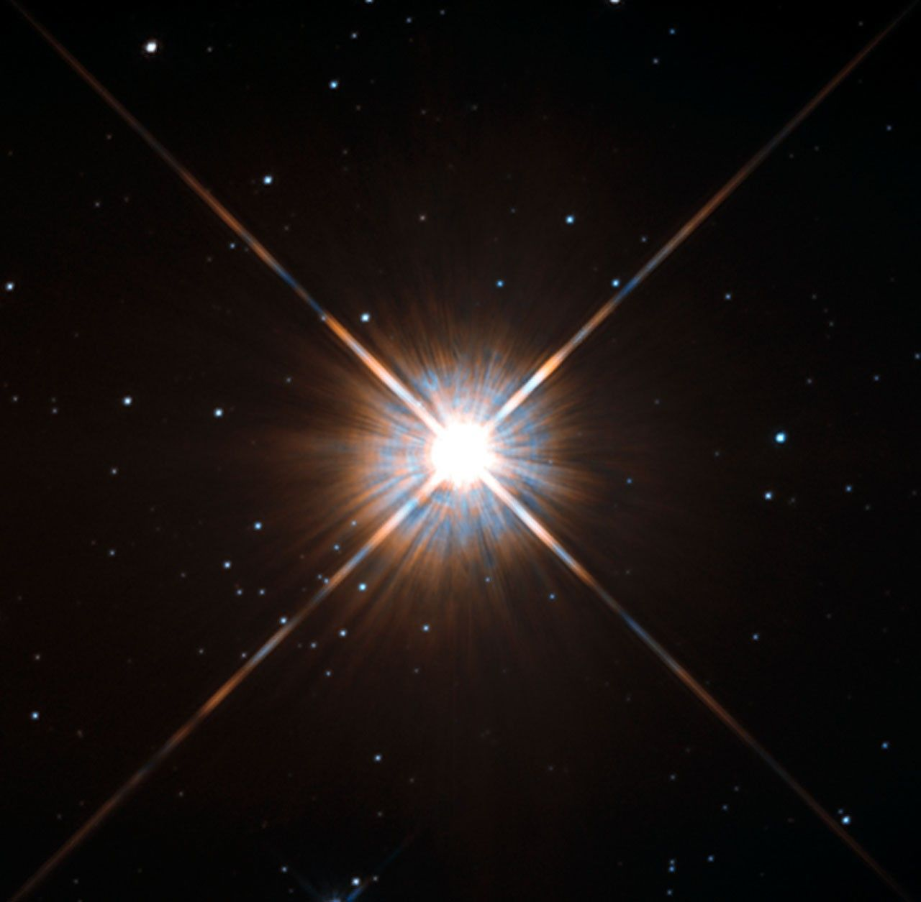
FIND THE DIFFERENCE

Slide 4
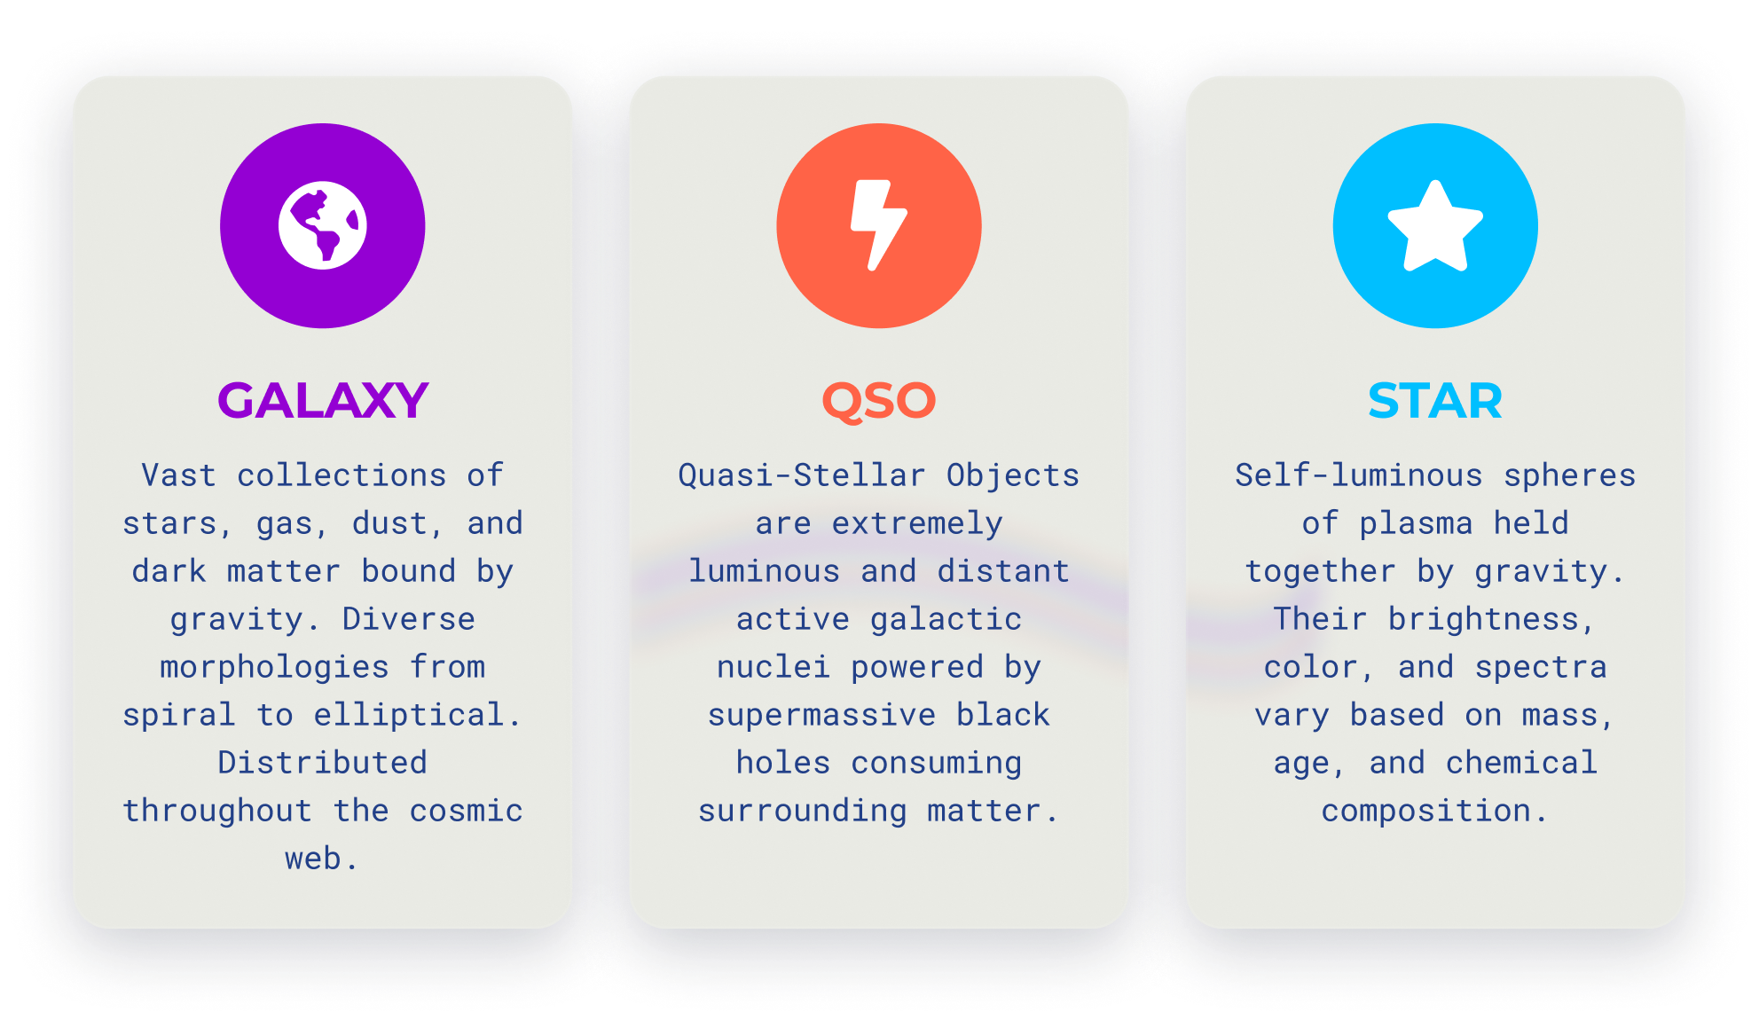
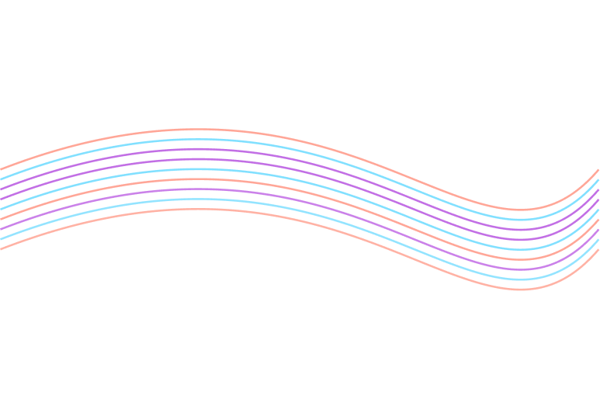
Introduction
To automate the the classification of celestial objects — Stars, Galaxies, and Quasars — using SDSS (Sloan Digital Sky Survey) data:
SDSS generates 100,000+ celestial observations daily
Manual classification by astronomers = slow & expensive
Need: Fast, accurate, automated classification
Why It Matters:
Accelerates cosmic discovery
Enables large-scale sky surveys
Frees up astronomers for complex analysis
Our Solution:
Machine Learning pipeline for 3-class classification
Stars ⭐ | Galaxies 🌌 | Quasars ✨
Goal: 95%+ accuracy with production-ready deployment

Slide 5
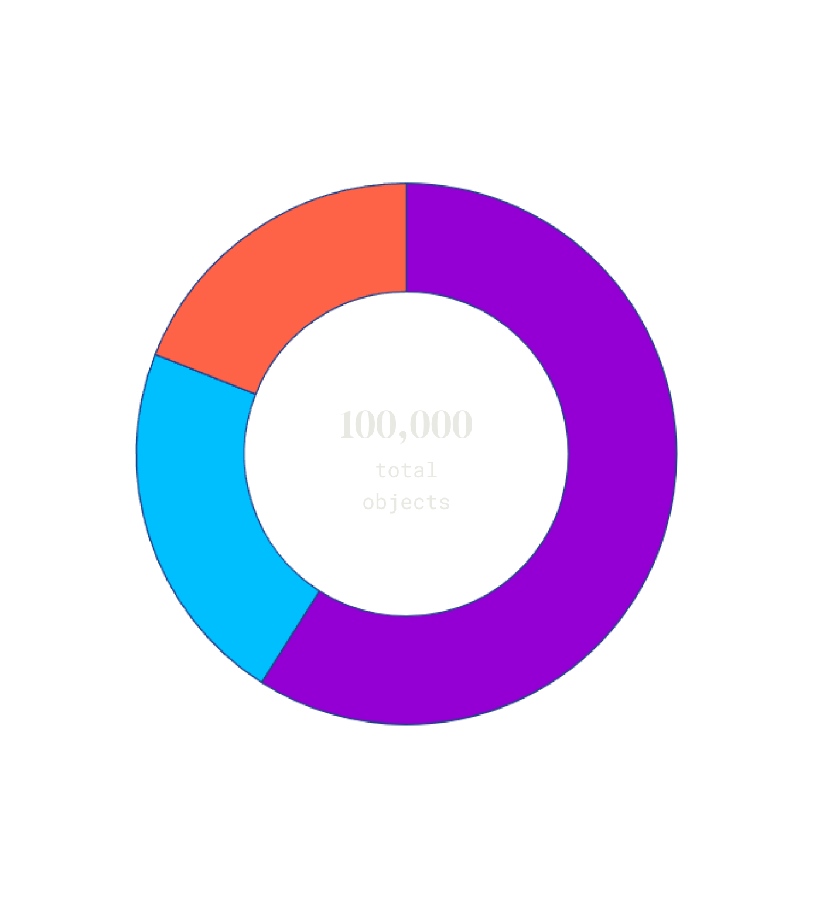
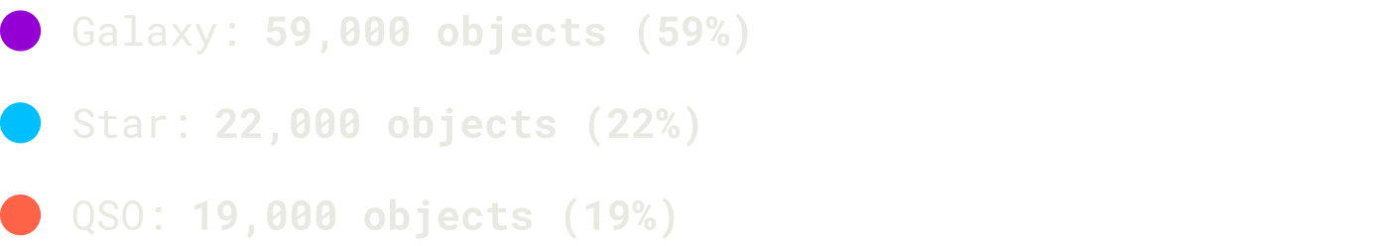
Data Overview
Our dataset comprises over 100,000 astronomical objects classified into three distinct categories: Galaxies, Quasars (QSOs), and Stars. Each object is characterized by photometric measurements across multiple wavelength bands.
The data shows significant class imbalance, with galaxies representing approximately 59% of all objects. This imbalance requires careful consideration during model training to ensure fair representation of all classes.

Slide 6
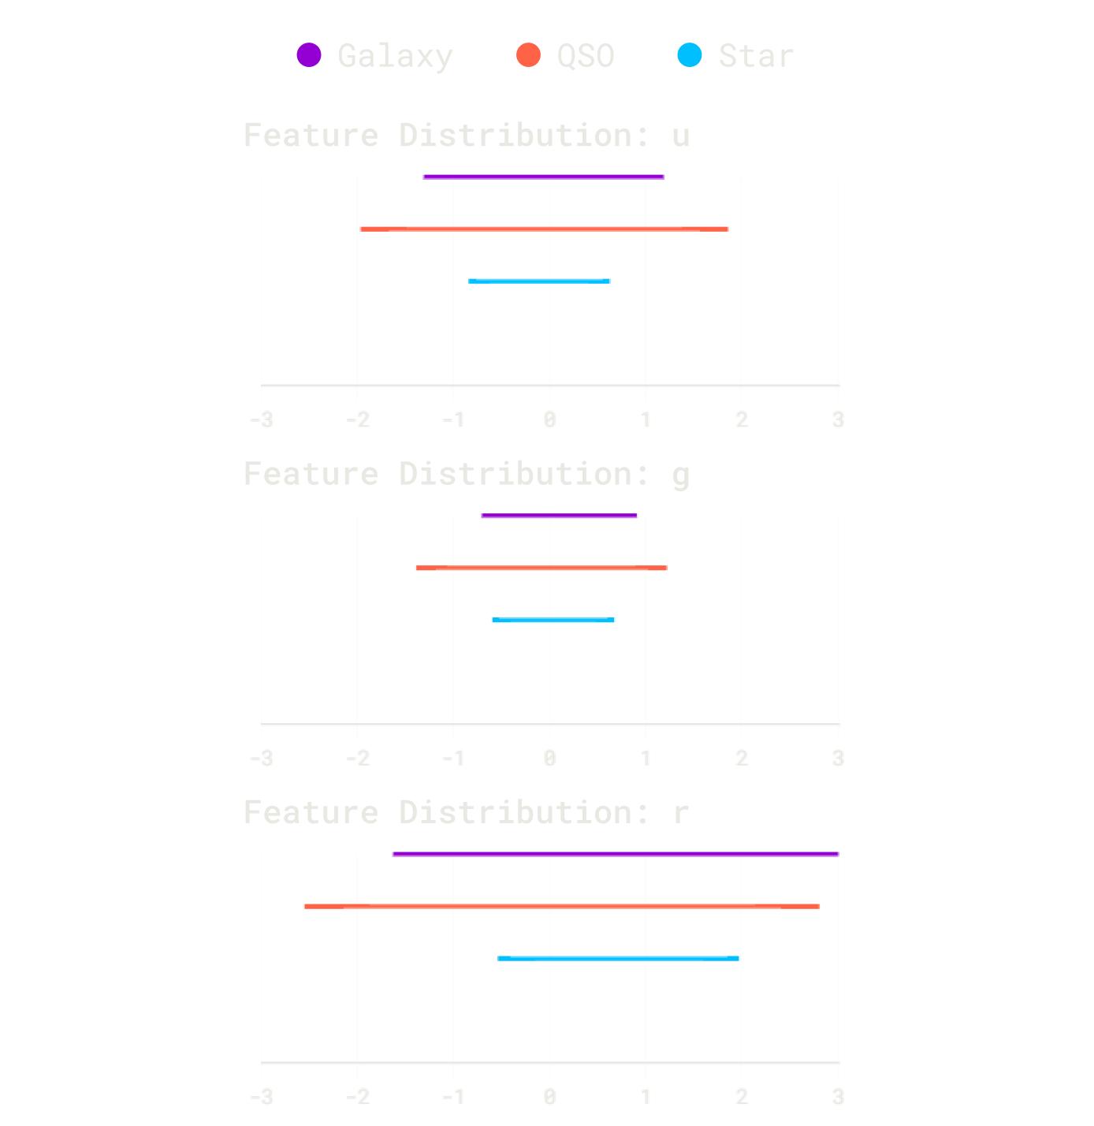
EDA
The EDA revealed clear patterns and helped refine the dataset for effective classification.
Key Insights:
Feature Selection: Systematically removed non-predictive metadata (e.g., obj_ID, MJD, alpha, delta) to focus purely on relevant physical properties.
Core Features: Confirmed that ugriz photometric colors and redshift are the most discriminative features for object classification.
Distinct Class Distributions:
Stars: Show tight clustering (narrow 'stellar locus').
Galaxies: Exhibit a broader, redshift-dependent distribution.
Quasars (QSOs): Have the widest spread and occupy distinct regions.
Model Suitability: These clear separations and patterns in the data's feature space (especially across u, g, and r bands) indicate that models adept at handling non-linear relationships, such as tree-based algorithms, are well-suited for this task.

Slide 7
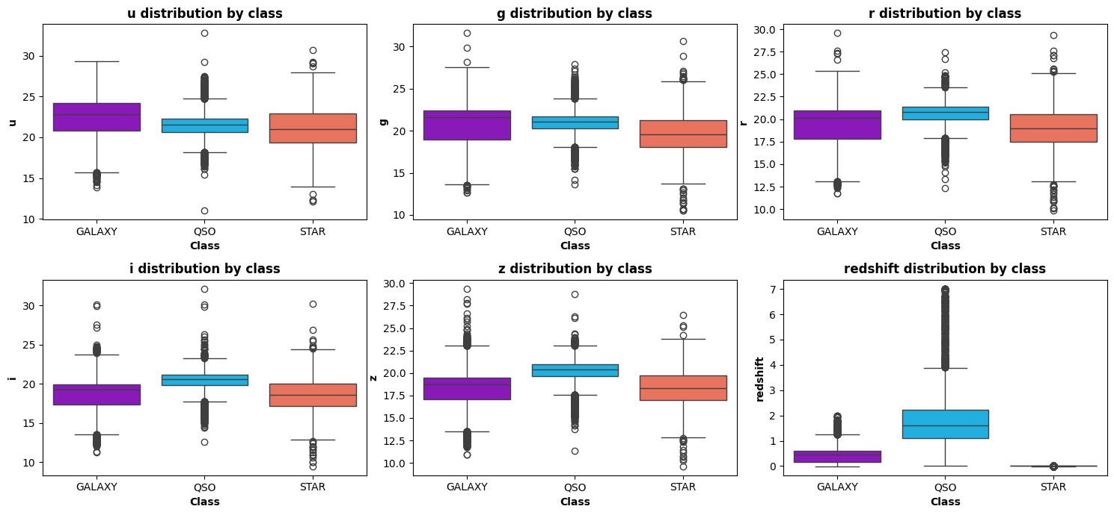
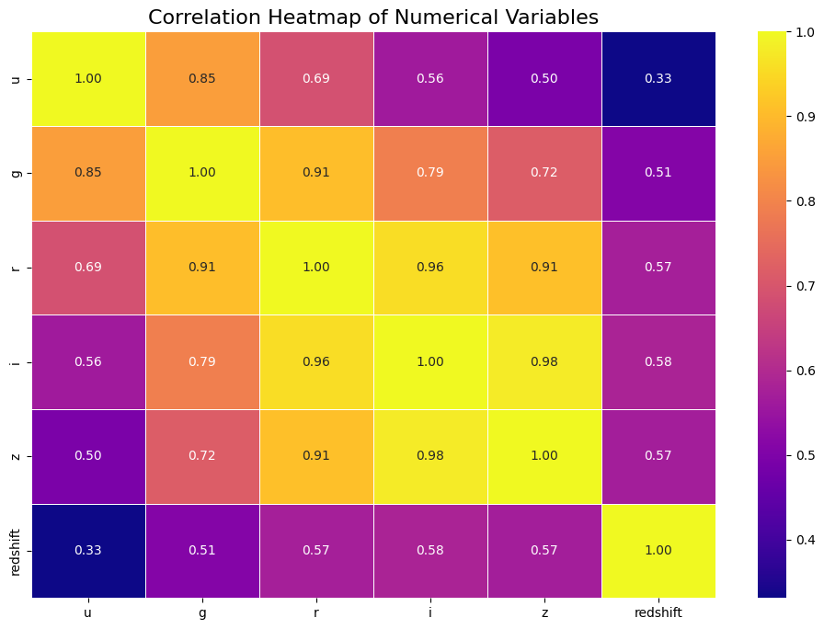
figures

Slide 8
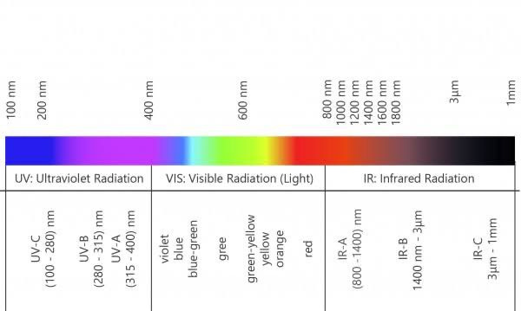

Light
Spectrum

Slide 9
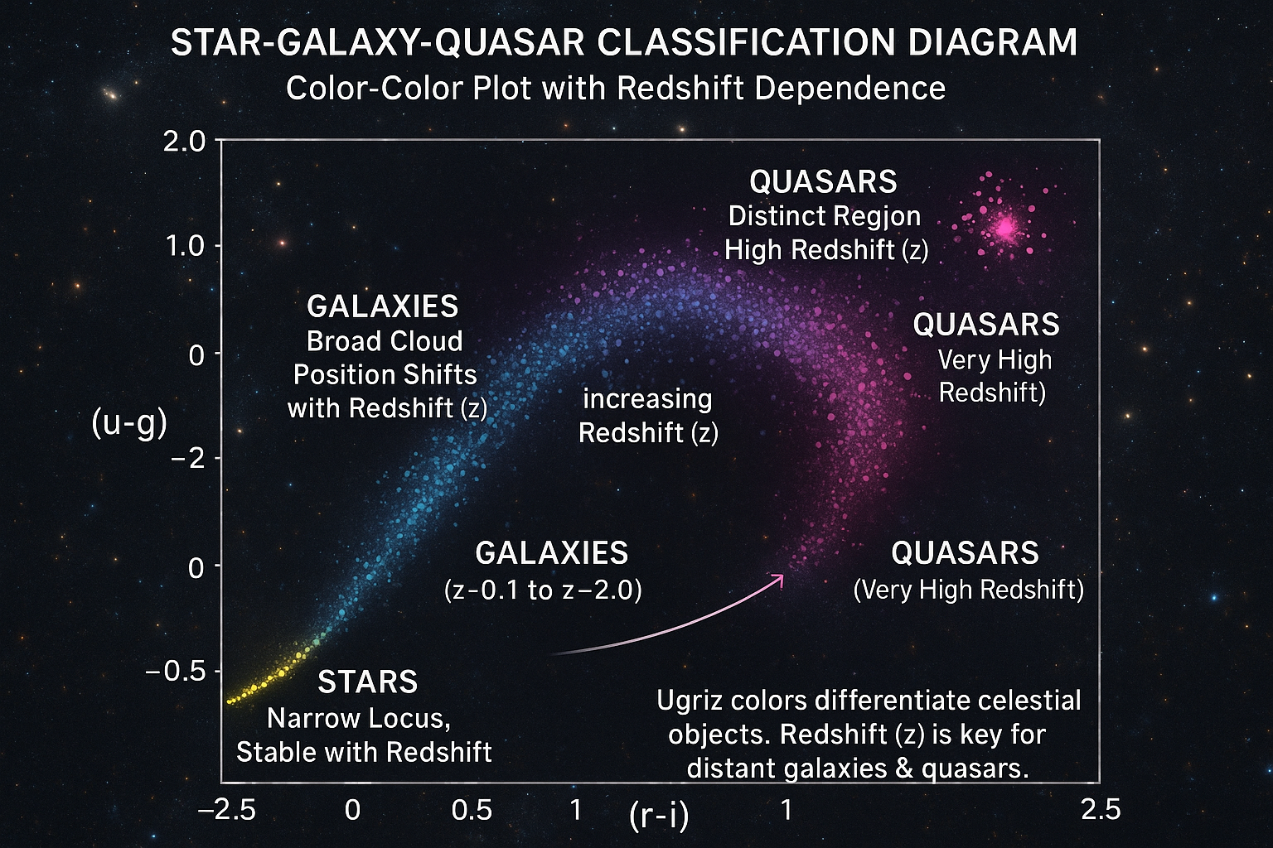
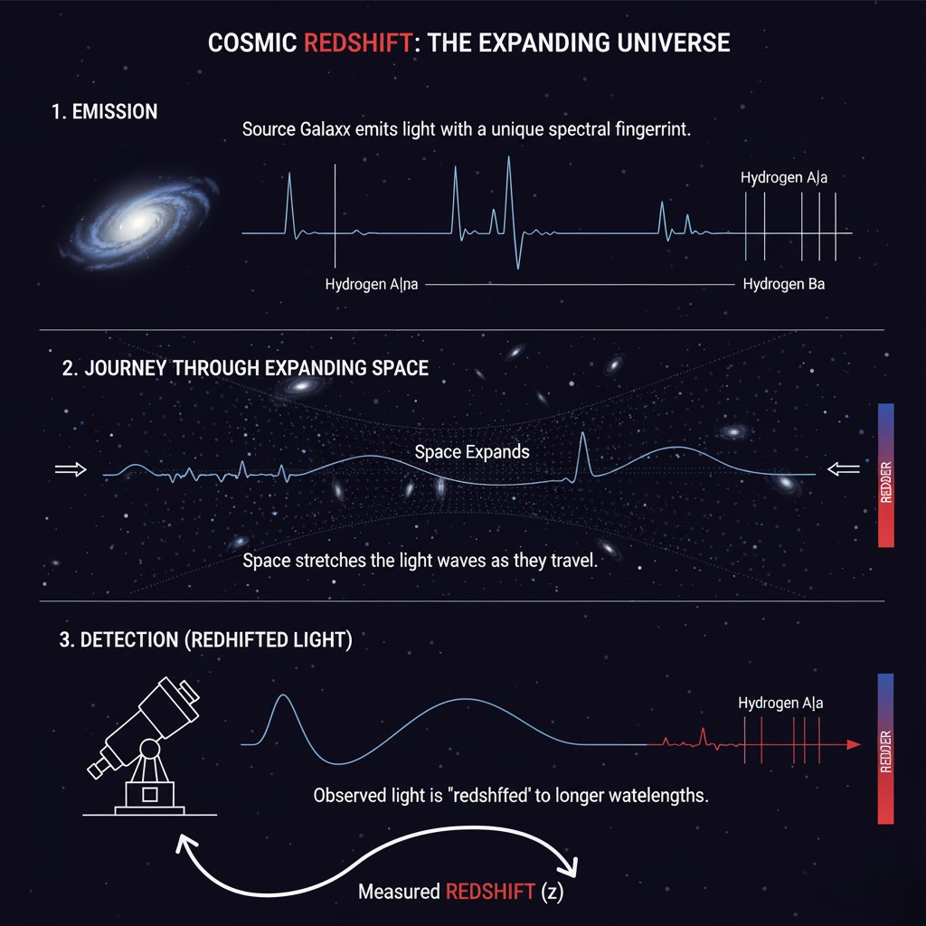

Slide 10
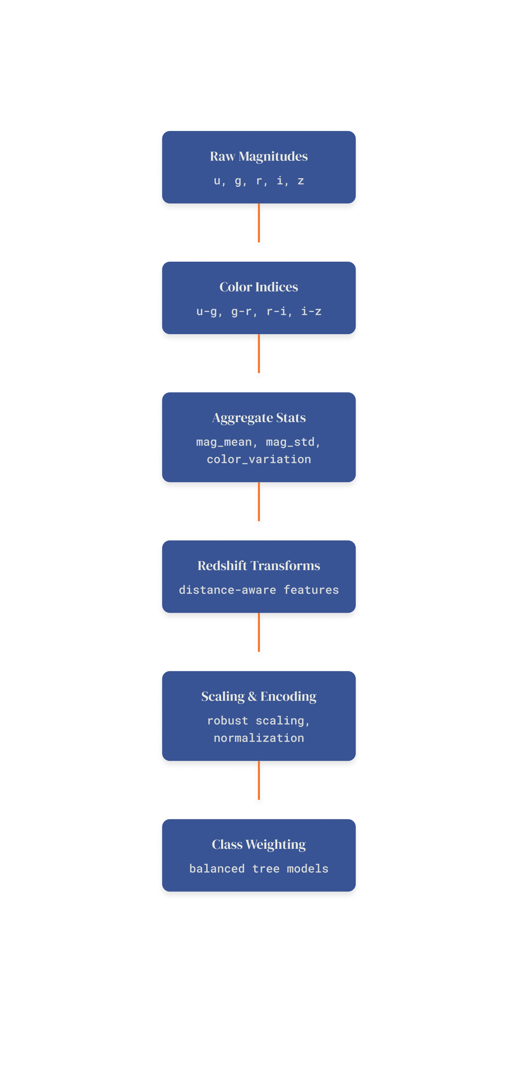
Feature Engineering & Data Pipeline
To optimize the data for modeling, I transformed raw features and built a robust preprocessing pipeline.
Key Actions:
Data Cleaning:
Missing Values: Confirmed the dataset had no missing values, eliminating the need for imputation.
Outlier Removal: Statistically identified and removed extreme outliers to enhance model robustness and prevent skewed training.
Feature Creation (Domain-Driven):
Color Indices: Engineered four new, highly discriminative features: (u-g), (g-r), (r-i), and (i-z). These capture the unique 'color signatures' vital for distinguishing stars, galaxies, and quasars.
Magnitude Statistics: Created mag_mean and mag_std to summarize each object's average brightness and variability across all photometric bands.
Preprocessing Pipeline:
Standardization: Applied StandardScaler to all features. This crucial step centers the data (mean=0, std=1), ensuring features contribute equally to model training and improving algorithm performance.
Pipeline Integration: All these steps were integrated into a systematic data pipeline for consistent and reproducible data transformation.

Slide 11
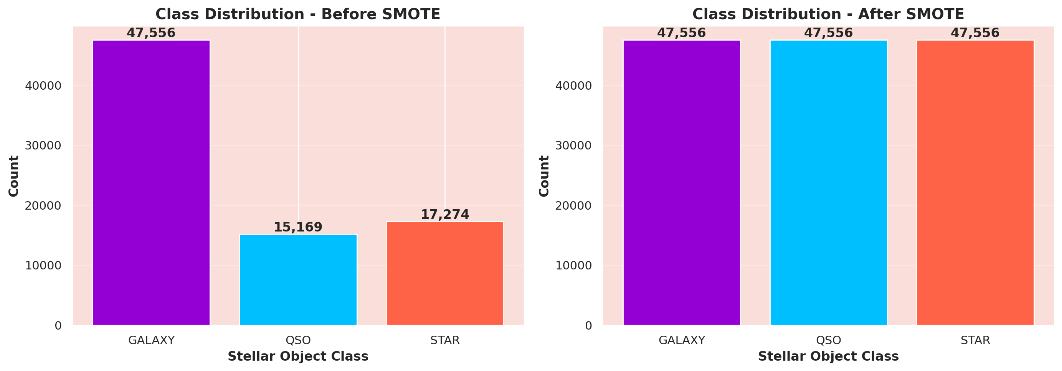
SMOTE
My dataset presented a significant class imbalance, which
I addressed to ensure robust model performance.
Challenge & Strategy:
Observed Imbalance: As seen in the "Before SMOTE" chart on the left, Galaxies are the majority class (47,556 samples), heavily outnumbering QSOs (15,169) and Stars (17,274). This imbalance could lead models to favor predicting the majority class.
Balancing Strategy:
For specific models, I applied SMOTE (Synthetic Minority Over-sampling Technique) to the training data. The "After SMOTE" chart on the right shows how this brought all classes to an equal count (47,556 samples each).
Additionally, I utilized class weights for tree-based models, inversely weighting classes to give more importance to the underrepresented ones during training.
Evaluation Note:
While I balanced the training data, I maintained the natural class distribution in my validation and test sets. This ensures my performance metrics truly reflect how the model would behave on real-world, imbalanced astronomical data.

Slide 12
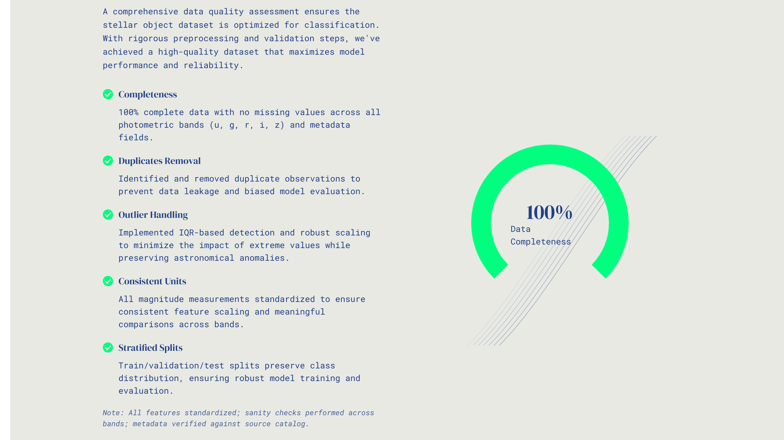

Slide 13

MODEL SELECTION
Multiple models are evaluated; The selection is based on the log loss for training, testing, and validation errors. The best-performing model is chosen for further tuning.
1
2
3
Random Forest
XGBoost
Gradient Boosting
4
5
Logistic Regression
Support Vector Machine (Linear)

Slide 14
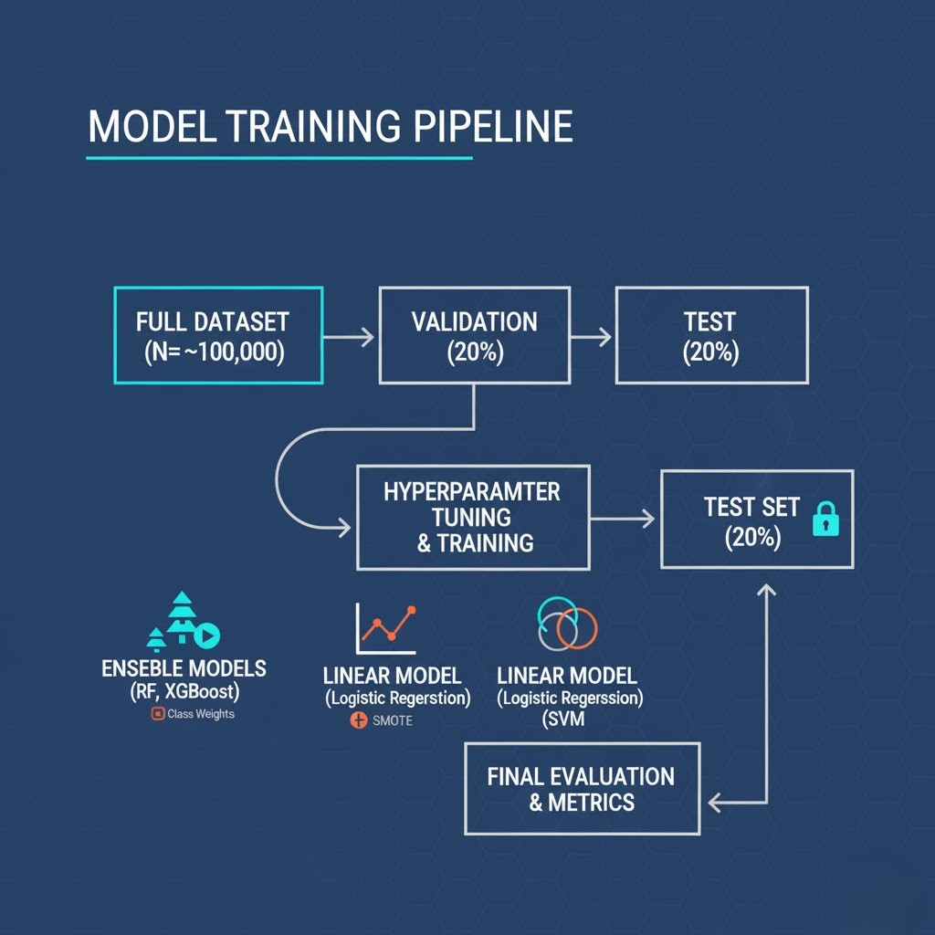
Model Training
With a refined dataset, I proceeded to train several machine learning models to classify stellar objects.
My Approach:
Data Split: I partitioned the dataset into a 60% training set, a 20% validation set (for hyperparameter tuning), and a 20% held-out test set for final, unbiased evaluation.
Model Selection: I explored a diverse set of algorithms, including:
Ensemble Tree-Based Models: Random Forest, XGBoost, and Gradient Boosting (known for handling complex relationships).
Linear Models: Logistic Regression.
Kernel-Based Models: Support Vector Machine (SVM).
Hyperparameter Tuning: I optimized each model's hyperparameters using the validation set to maximize performance.
Class Imbalance Handling: During training, I incorporated techniques like class weighting and SMOTE (as discussed) to ensure models learned effectively from all object classes.
This systematic training process prepared the models for robust performance evaluation, which I will present in the results.

Slide 15
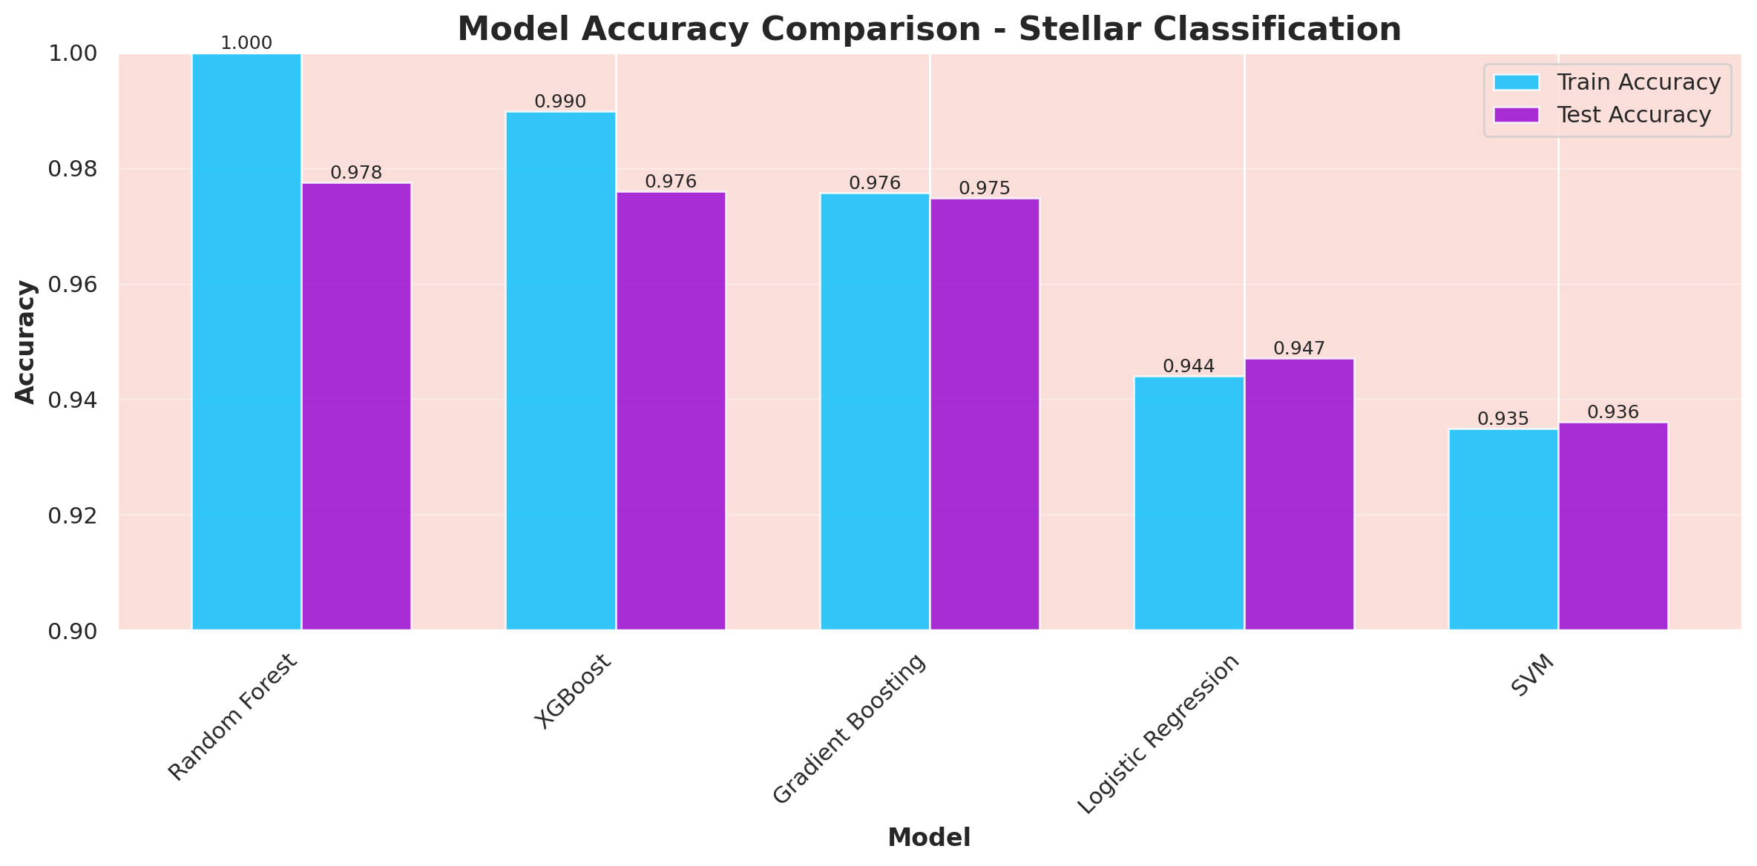
Results
After training, I rigorously evaluated each model's performance, confirming the effectiveness of my approach.
Key Findings:
Overall Accuracy Comparison:
Model Accuracy Comparison - Stellar Classification
Insight: As shown in the bar chart, Random Forest emerged as the top-performing model with a test accuracy of 97.8%. XGBoost and Gradient Boosting also performed exceptionally well, all demonstrating strong generalization (low train-test accuracy gap). Linear models like Logistic Regression and SVM showed comparatively lower accuracy, indicating the non-linear complexity of the data.

Slide 16
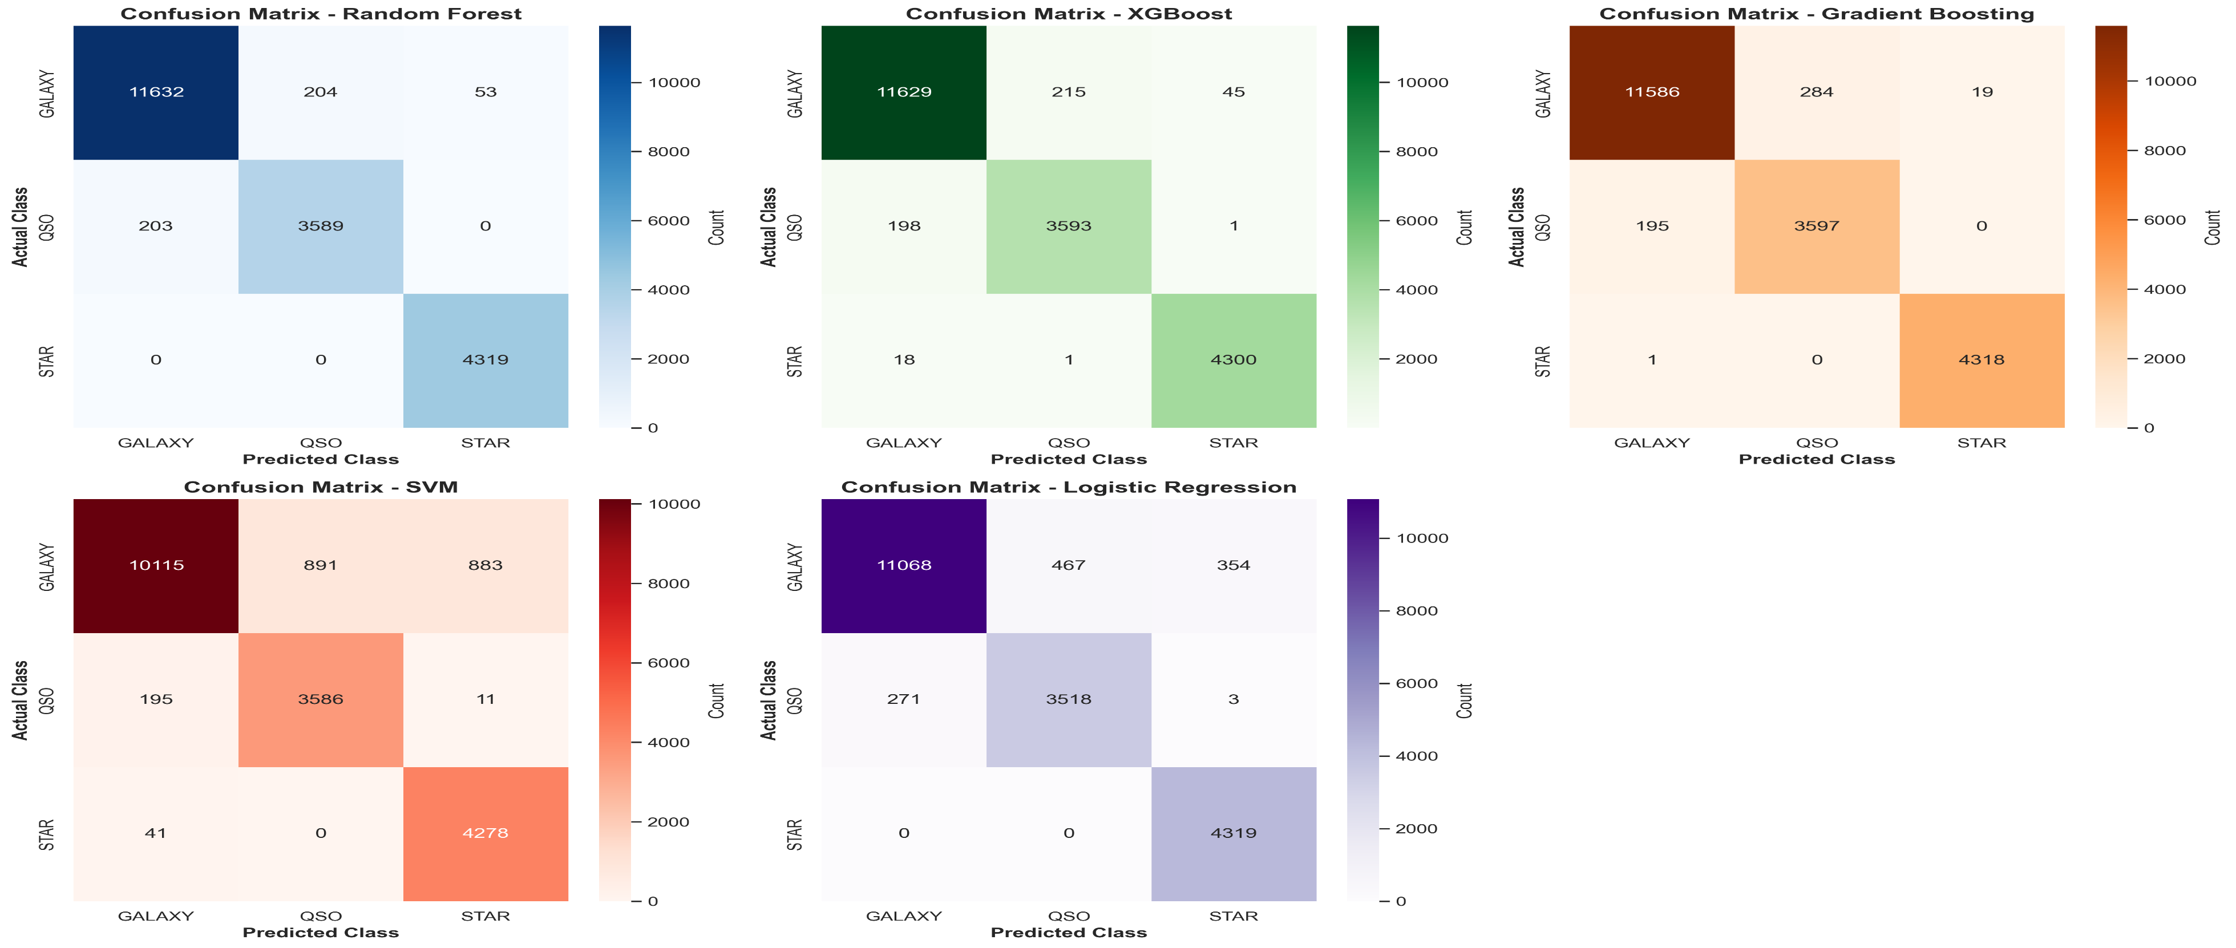
Detailed Class Performance (Confusion Matrices):
Confusion Matrix for each model
Insight: The confusion matrices provide a granular view of how each model classifies individual object types. Random Forest, XGBoost, and Gradient Boosting consistently achieved very high true positive rates across all three classes (Galaxy, QSO, Star).
Specifically, Random Forest correctly identified a very high proportion of Galaxies and Stars.
While all models performed well, the top ensemble models showed minimal misclassifications, especially in distinguishing QSOs, which can be a challenging class due to their star-like appearance. This confirms their ability to accurately separate even visually similar objects using the engineered features.

Slide 17
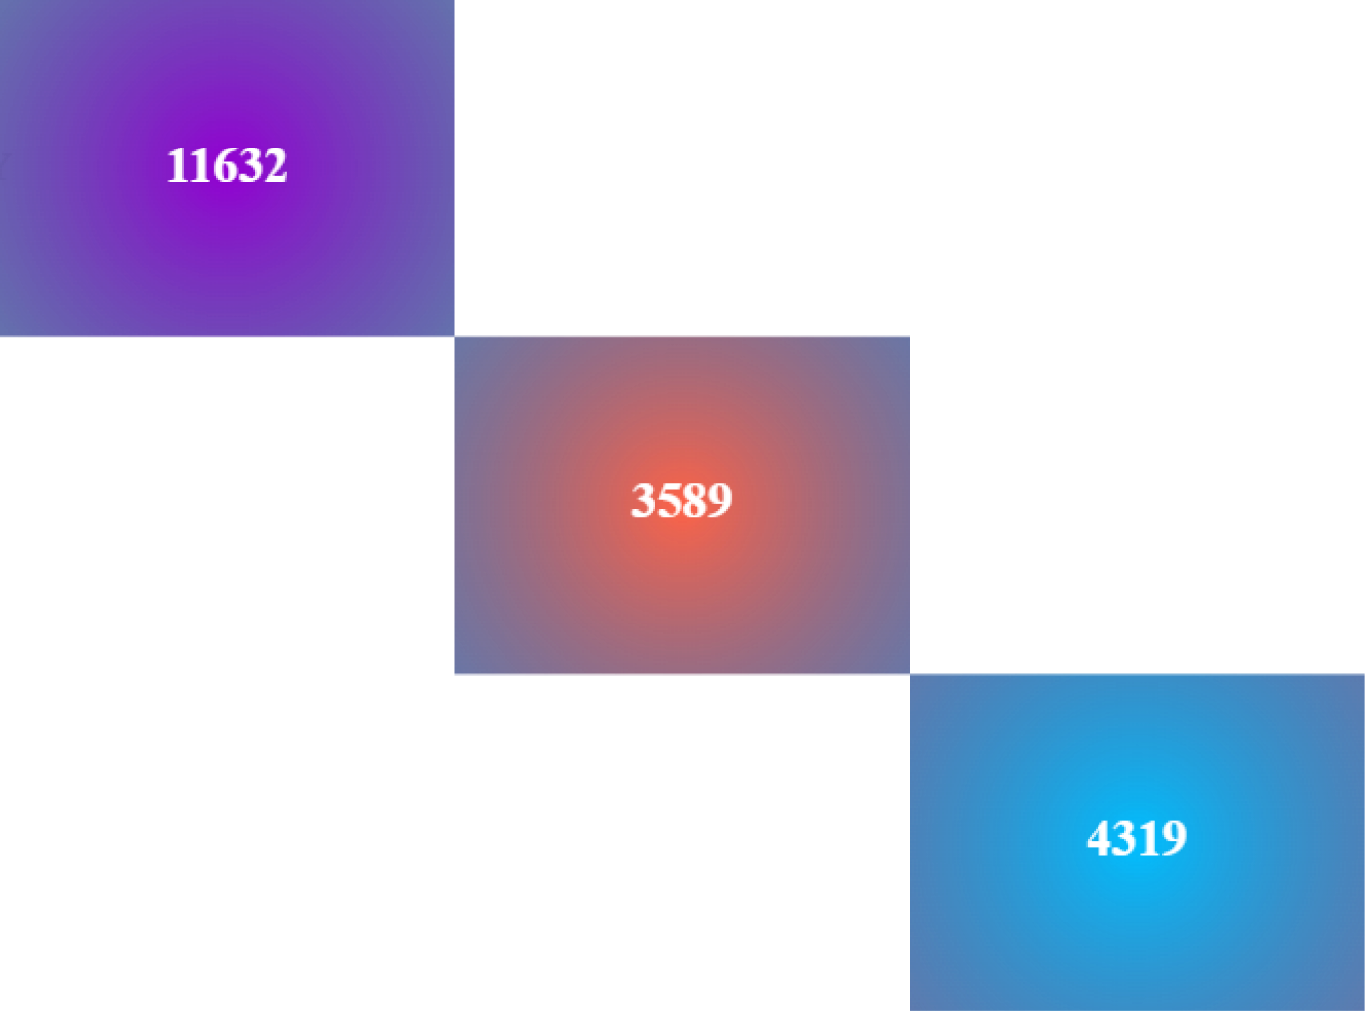
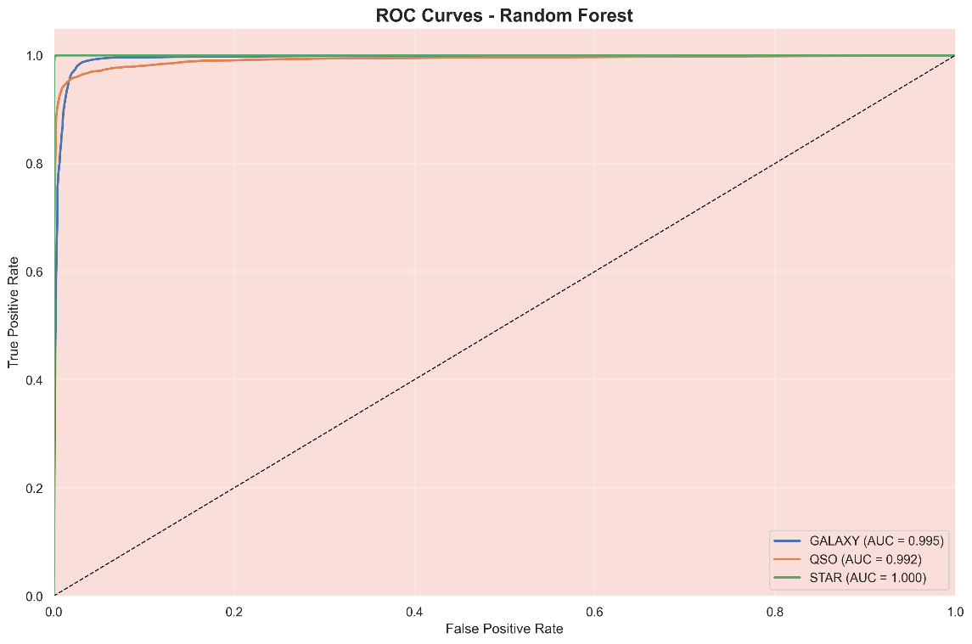
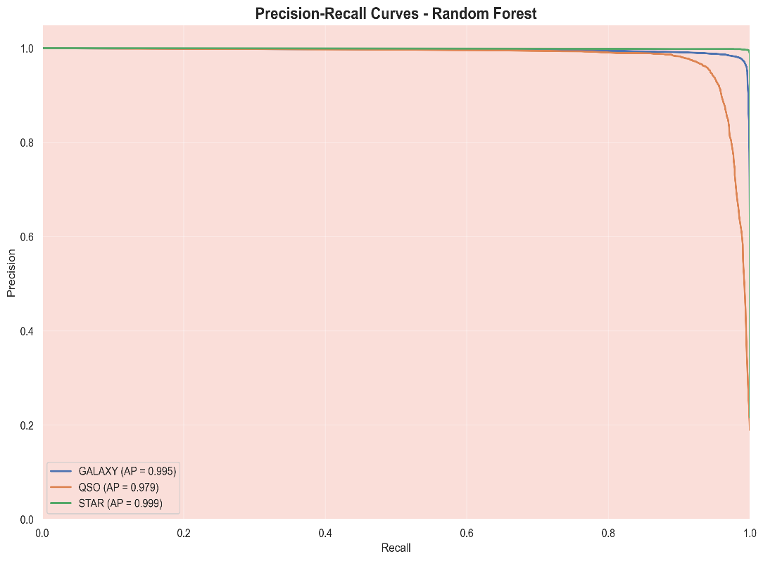
Robustness Across Classes (ROC & Precision-Recall):
ROC Curves - Random Forest and Image 4: Precision-Recall Curves - Random Forest
Insight: Focusing on the best-performing model, Random Forest, the ROC curves with high AUC (Area Under the Curve) values (close to 1.0 for all classes) and the Precision-Recall curves with high Average Precision (AP) confirm its excellent discriminative power. This indicates that the model is not only accurate but also robust in correctly identifying positive instances for each class while minimizing false positives, even for the minority classes.
Conclusion: The Random Forest model stands out as the most effective classifier for stellar objects in this project, demonstrating high overall accuracy and strong performance across all object classes, validating the feature engineering and class imbalance strategies implemented.

Slide 18
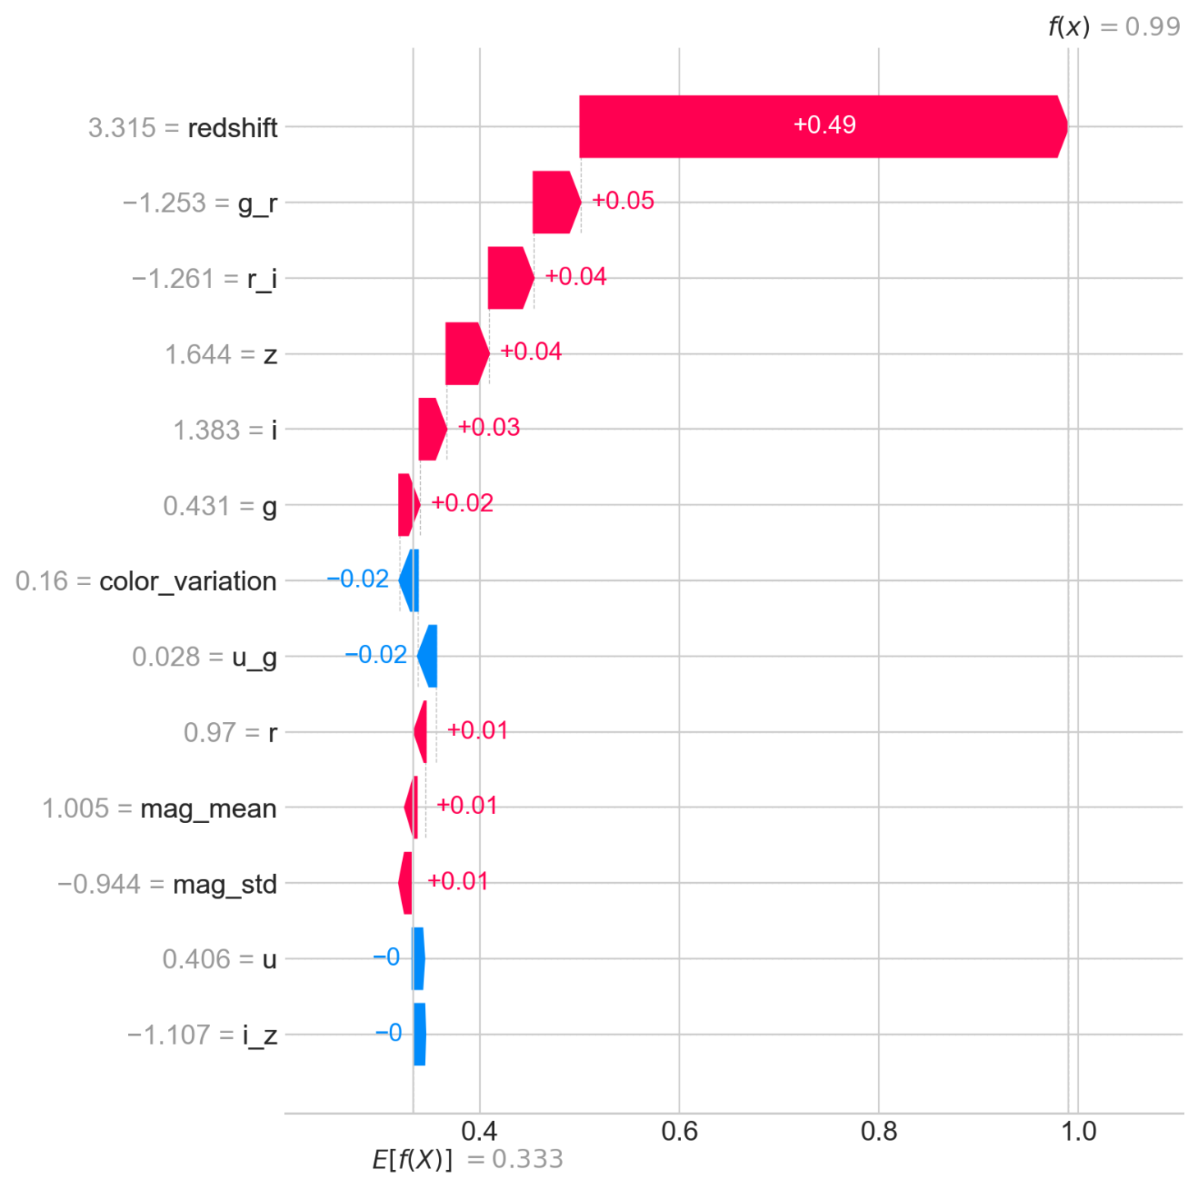
Interpretability - SHAP
To ensure my model isn't a "black box," I utilized SHAP (SHapley Additive exPlanations) values to interpret feature importance and understand individual predictions.
Key Insights:
Global Feature Importance (SHAP Summary Plot):
SHAP Explanations
Insight: This plot shows the overall impact of each feature on the model's predictions. Clearly, redshift is by far the most influential feature, having the largest positive impact on a prediction. Following redshift, color indices like g_r, r_i, and z also play significant roles. This reinforces my initial EDA and feature engineering choices – these are indeed the key discriminators. Other features, like color_variation, u_g, and mag_mean, contribute, but to a lesser extent.

Slide 19
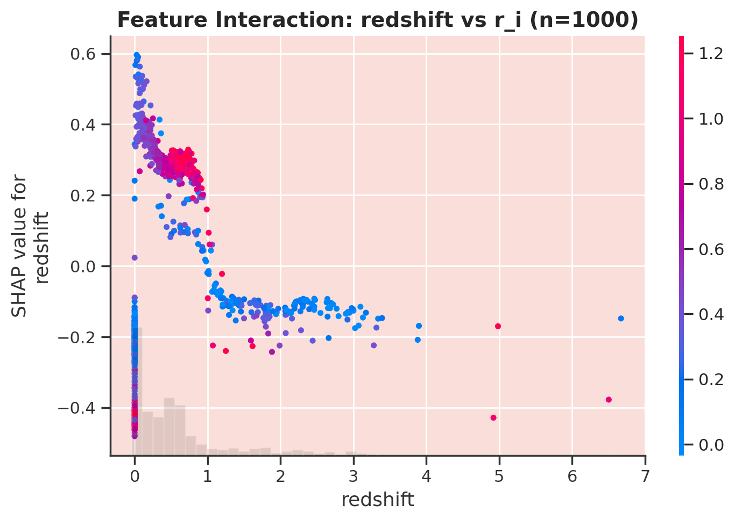
Feature Interactions (SHAP Dependence Plot):
Feature Interaction: redshift vs r_i (n=1000)
Insight: This plot specifically examines how redshift interacts with another important feature, r_i, to influence predictions.
It shows that as redshift increases (moving right on the x-axis), its SHAP value often changes, indicating its impact on the prediction shifts.
The color bar (representing r_i) further illustrates complex interactions: for example, at higher redshifts, the r_i value can significantly modify how redshift itself influences the prediction. This type of interaction is something a simple linear model would miss, highlighting why my ensemble models excelled.
Conclusion: SHAP values provide valuable transparency, confirming that my model bases its decisions on the scientifically relevant features I identified and revealing nuanced interactions that contribute to its high accuracy. This deepens my confidence in the model's astronomical validity.

Slide 20
Streamlit - Deployment
I've deployed my best-performing Random Forest model into an interactive Streamlit web application, making it accessible and user-friendly.
My Deployment Implementation (app.py):
Streamlit Web Application: I developed a Streamlit application (app.py) that serves as an intuitive interface for my stellar object classification model. This moves beyond a backend API to a full-fledged, interactive tool.
Key Features of the App:
"Predict" Interface: Allows users to input new photometric data (ugriz colors, redshift, etc.) and receive immediate class predictions (Star, Galaxy, Quasar) from the Random Forest model.
"Explore Data" Section: Provides visualizations (like the Color-Color Diagram) to help users understand the underlying data distributions.
"Performance" & "Interpretability" Sections: Showcases model evaluation metrics (e.g., confusion matrices, accuracy) and SHAP-based interpretations directly within the app, fostering transparency and trust.
Integrated Pipeline: The application seamlessly incorporates the entire preprocessing pipeline (StandardScaler, feature engineering) ensuring that user-inputted data is correctly transformed before being fed to the Random Forest model.
Model Persistence: The trained Random Forest model is saved and loaded by the Streamlit app at startup, enabling efficient real-time predictions.
This interactive Streamlit application successfully bridges the gap between my machine learning model and its practical application, providing a powerful tool for rapid, data-driven stellar object classification.

Slide 21
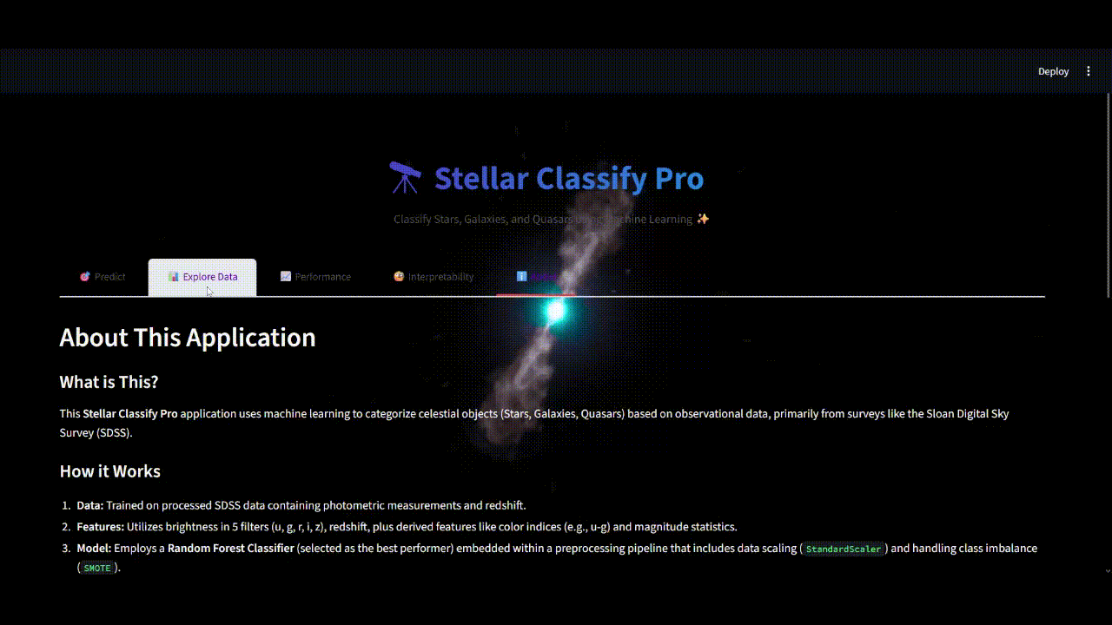
Conclusion

Slide 22
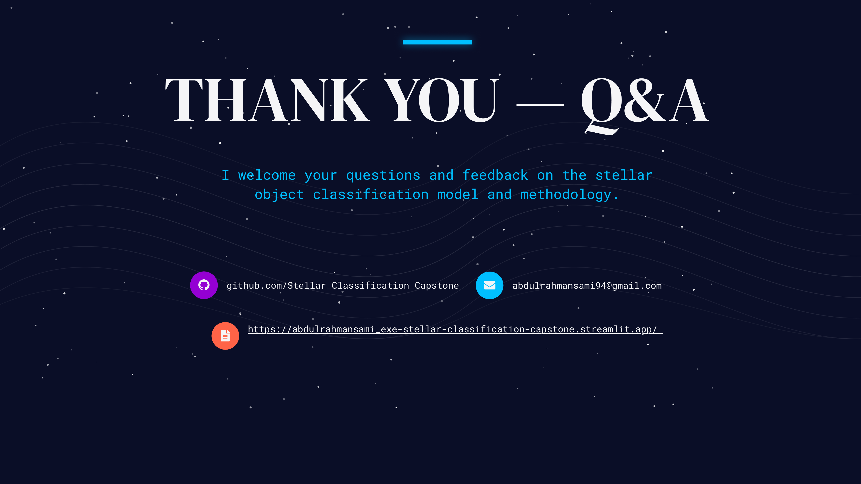
THANK
YOU

